Slide 1









E-BOT
DR.SAMAR HESHAM

Slide 2





Introduction
Welcome to our Emergency Interactive Chatbot Medical Assistance—an innovative solution for swift and efficient support during critical medical situations.
In times of urgency, access to accurate information and guidance can be a game-changer.
Our intelligent chatbot seamlessly blends advanced technology with compassionate care to provide immediate assistance.
Experience the future of emergency medical support with our innovative chatbot—because every second counts when it comes to saving lives.

Slide 3

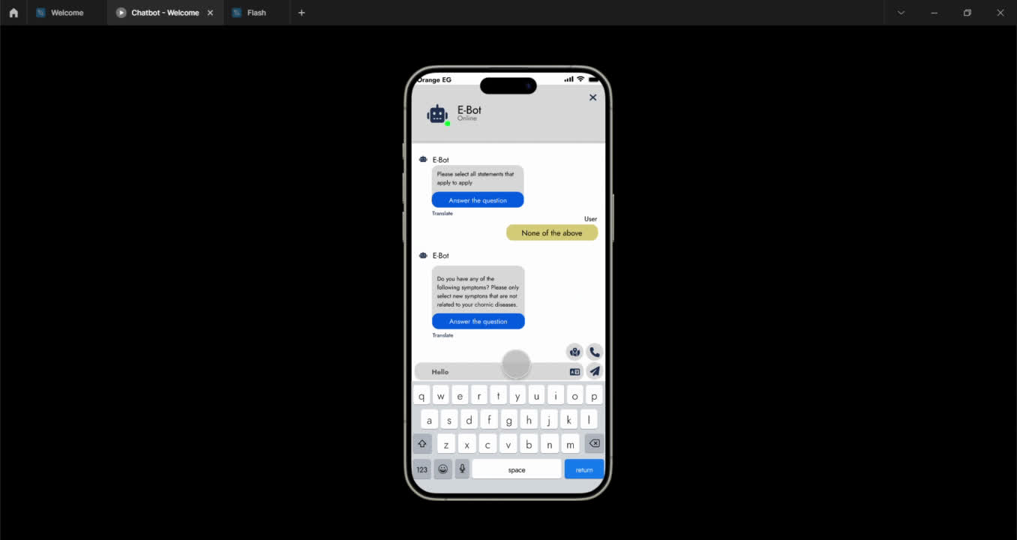




Slide 4




Problem & solution

Slide 5




PROBLEM
-The delayed administration of first aid for individuals with chronic illnesses and sudden health crises often results in many cases of fatalities
-Lack of awareness of emergency contact numbers and nearby hospital locations contributes to the challenge.

Slide 6
SOLUTION
-This app will be like an assistant that displays first aid tips you may need in emergency situations.
-In special cases, the app will directly connect to emergency services or one of the numbers specified by the user for immediate contact.

Slide 7
Functional requirements

Slide 8


functional requirements
Real-time Symptom Assessment
Emergency Protocol Guidance
24/7 Accessibility
AI-Powered Triage
Natural Language Processing (NLP)
Multilingual Support
User Education and Awareness
Up-to-Date Medical Knowledge

Slide 9
non functional requirements

Slide 10
non functional requirements
Security
Usability
Availability
Performance
Reliability
Scalability
Compatibility
Maintainability

Slide 11
why we use AI ?

Slide 12
AI
A. Symptom Diagnosis:
Problem: Users input their symptoms, and the chatbot needs to identify potential diseases.
• Solution: Utilize natural language processing (NLP) techniques to understand user input and match it with a database of symptoms and corresponding diseases.
B.Algorithms:
NLP Algorithms: Use algorithms like word embeddings (e.g., Word2Vec, GloVe) to represent symptoms and diseases in a high-dimensional vector space, allowing for semantic similarity calculations.
• Machine Learning Models: Train machine learning models (e.g., SVM, decision trees, neural networks) on labeled datasets to predict diseases based on symptoms.

Slide 13
AI
-Disease Information:
Problem: Once the disease is identified, users seek information about it.
• Solution: Provide concise yet comprehensive information about the disease, including causes, symptoms, treatments, and prevention measures.
-Algorithms:
Information Retrieval: Retrieve relevant information from medical databases or reliable sources using techniques like keyword matching, topic modeling, or summarization.
-Hospital Recommendations:
Problem: Users may require immediate medical attention, so the chatbot should suggest nearby hospitals.
• Solution: Utilize geolocation data and hospital databases to recommend the nearest healthcare facilities.
-Algorithms:
• Geospatial Analysis: Utilize algorithms like k-nearest neighbors (KNN) or spatial clustering to determine the proximity of hospitals to the user's location.

Slide 14


Related Work

Slide 15
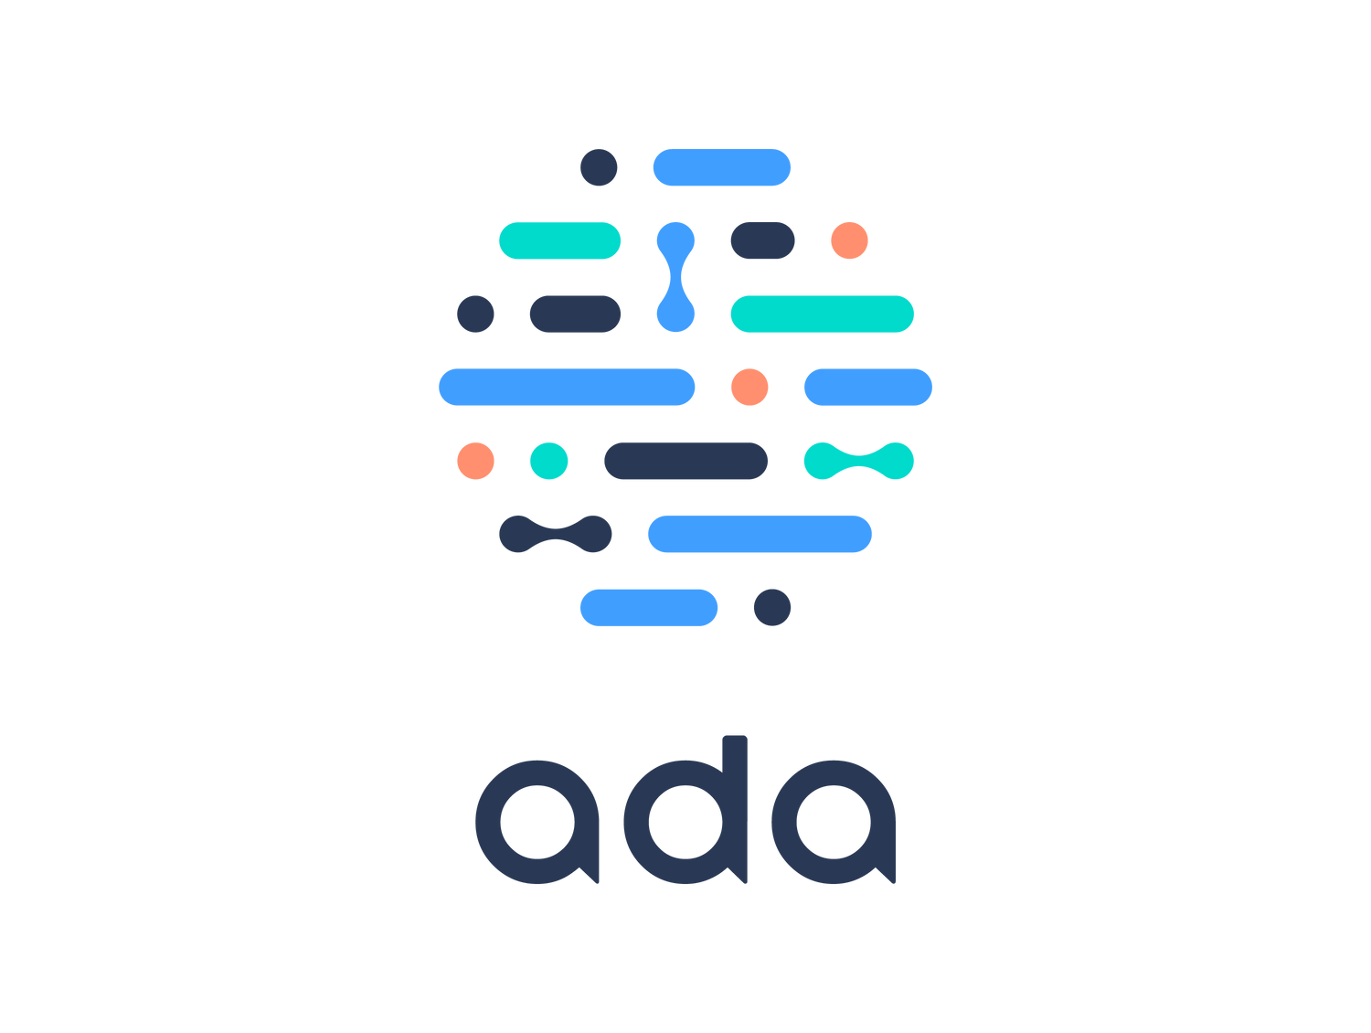


Ada Health
\

Slide 16



Advantage
Symptom Assessment
User-Friendly Interface
Accessible Anytime
Privacy and Confidentiality
Disadvantage
LIMITED TO SYMPTOM ASSESSMENT
LACK OF HUMAN INTERACTION
POTENTIAL FOR MISINTERPRETATION
DEPENDENCE ON TECHNOLOGY

Slide 17
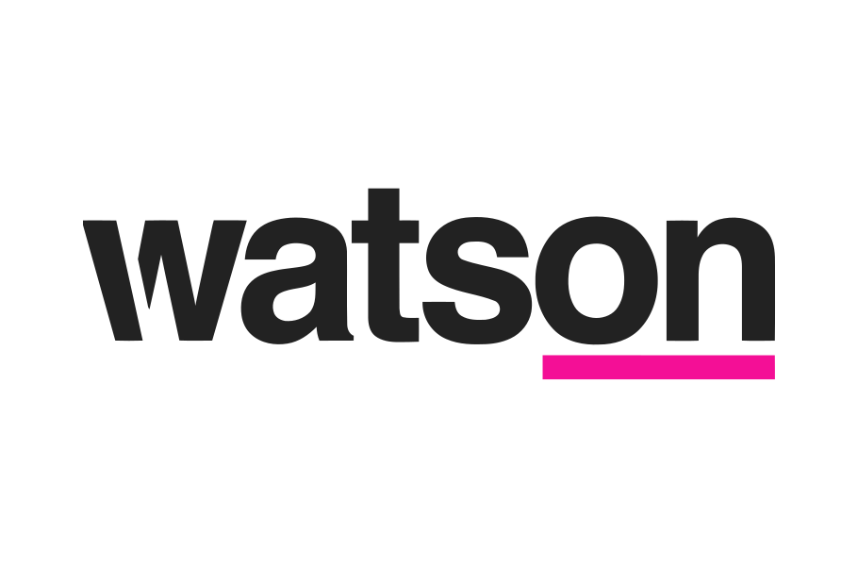
IBM Watson Health

Slide 18
Advantage
AI-Powered Insights:
Clinical Decision Support:
Personalized Medicine:
Data Integration:
Research and Drug Discovery:
Remote Patient Monitoring:
Disadvantage
COMPLEX IMPLEMENTATION
Data Privacy Concerns
Learning Curve for Users
Accuracy and Reliability
Limited Availability in Some Regions
COST

Slide 19
Objectives

Slide 20


Objectives
1
2
3
Real-time assistance and assessment of symptoms
first aid guidelines and integration with emergency services .
location based services and user-friendly and user education .

Slide 21
Technologies

Slide 22
Technologies
A. database:
we have opted for NoSQL databases due to their superior capabilities in several key areas:
1. Schema Flexibility: NoSQL databases offer schema-less or flexible schema features, allowing seamless storage of unstructured or semi-structured data commonly encountered in chatbot conversations.
2. Fast Read and Write Operations: NoSQL databases' optimized read and write operations enhance our chatbot's real-time responsiveness and performance. Thus, we've chosen to leverage a NoSQL database to meet our chatbot application's needs effectively.
B. backend scripting language :
we choose python to be our backend scripting language because it works well with flutter flow and Integrating Python backend services with Flutter allows developers to leverage existing data science libraries and tools to enhance their applications' functionality.
and we choose MongoDB
C. Mobile Application Development Framework:
we choose flutter flow because we found that is faster and simple to work with Developers can swiftly create and adjust UI components using a visual interface, and accelerating the design iteration process and no coding required

Slide 23

Diagrams

Slide 24


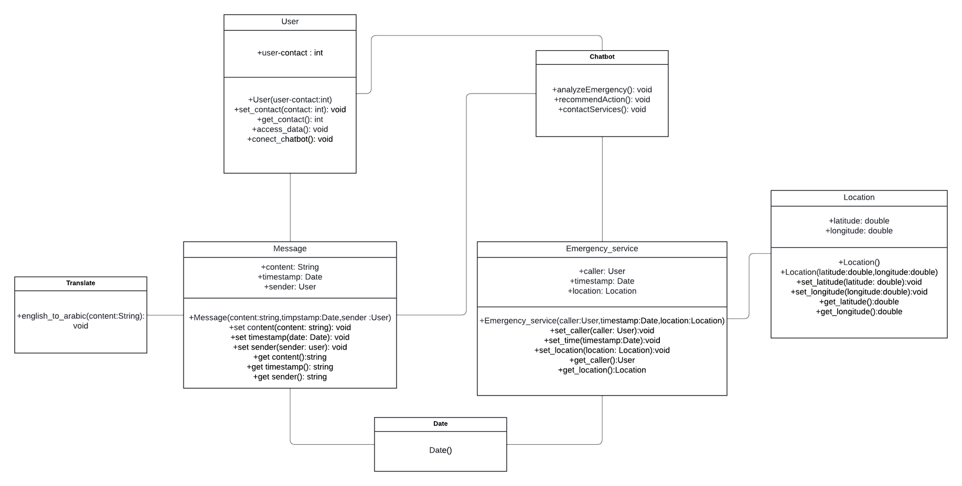

UML class diagram

Slide 25
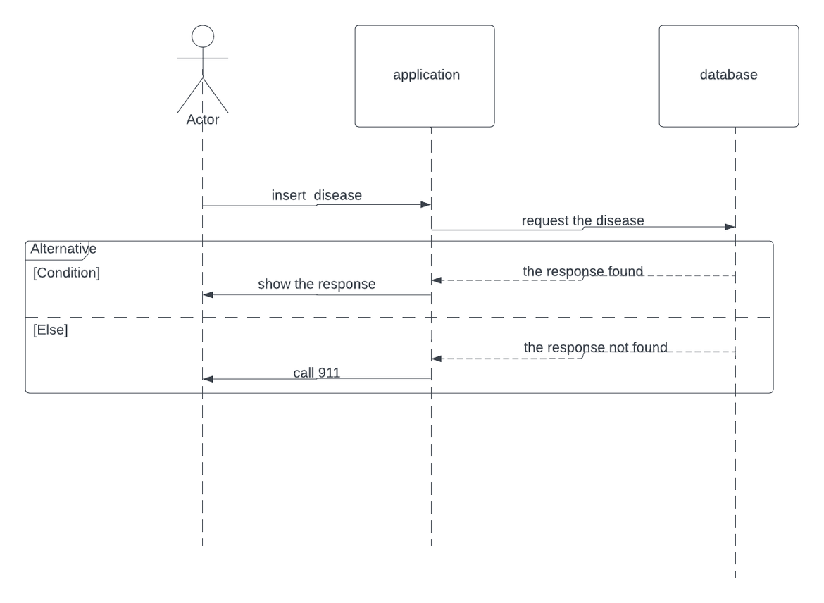
sequence diagram

Slide 26
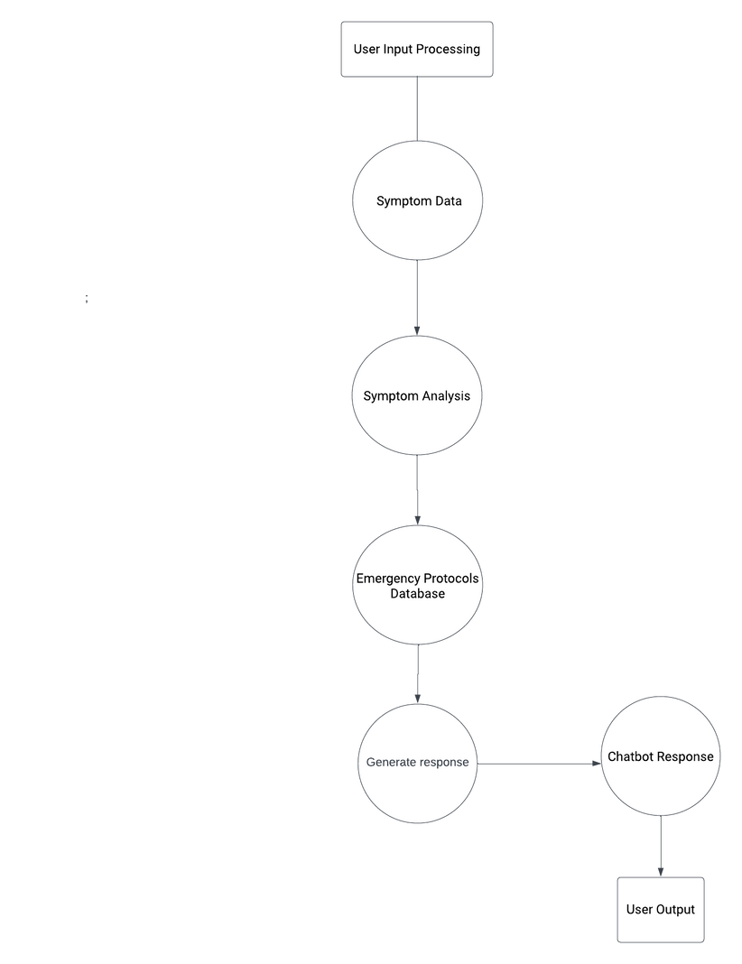
Dfd diagram

Slide 27
Conclusion
Our Emergency Interactive Chatbot Medical Assistance is more than a technological advancement; it's a lifeline. With precision and compassion, this chatbot empowers individuals during medical emergencies, offering immediate support, accurate guidance, and bridging the crucial gap until professional help arrives.
Experience the revolution—where cutting-edge technology meets unwavering commitment to your well-being. In emergencies, trust our chatbot to be your companion, ensuring that every second counts towards saving lives.

Slide 28


THANK YOU

